Slide 1



Airbnb Analysis
View in Power BI
Last data refresh:
02/05/2025 21:08:48 UTC
Downloaded at:
02/05/2025 21:10:10 UTC

Slide 2
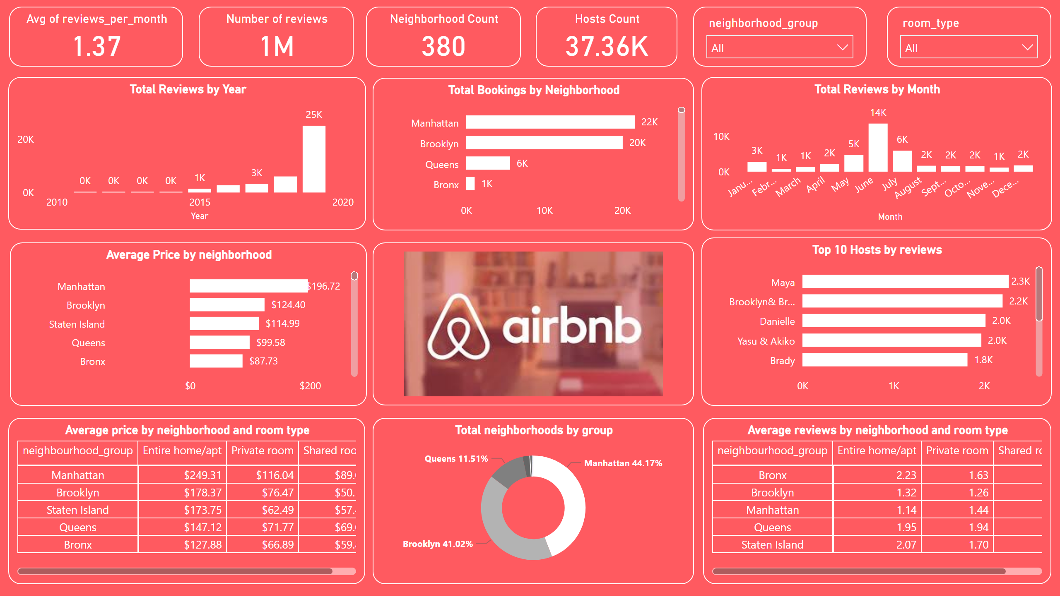
Page 1
Notes:
slicer
No alt text provided
slicer
No alt text provided
Hosts Count
No alt text provided
Avg of reviews_per_month
No alt text provided
Number of reviews
No alt text provided
Neighborhood Count
No alt text provided
Total Reviews by Year
No alt text provided
Total Reviews by Month
No alt text provided
Total Bookings by Neighborhood
No alt text provided
Average Price by neighborhood
No alt text provided
Top 10 Hosts by reviews
No alt text provided
Total neighborhoods by group
No alt text provided
Average price by neighborhood and room type
No alt text provided
Average reviews by neighborhood and room type
No alt text provided
image
No alt text provided

